Slide 1
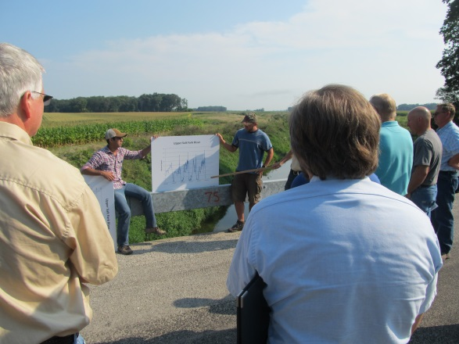
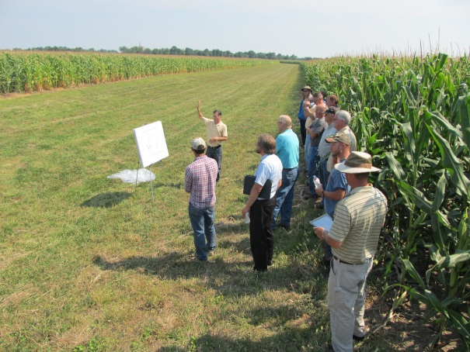
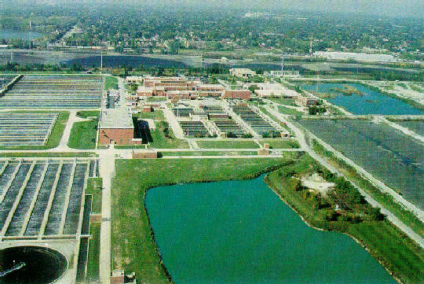
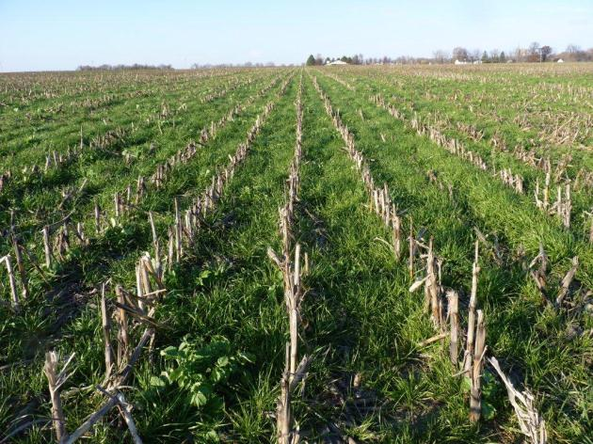
Science Assessment to Support an Illinois Nutrient Reduction Strategy
Mark David, Greg McIsaac, George Czapar, Gary Schnitkey, Corey Mitchell
University of Illinois at Urbana-Champaign
September 18, 2013
11-08-12

Slide 2
Technical Tasks
develop a science based technical assessment of:
  current conditions in Illinois of nutrient sources and export by rivers in the state from point and non-point sources
  methods that could be used to reduce these losses and estimates of their effectiveness throughout Illinois
  estimates of the costs of statewide and watershed level application of these methods to reduce nutrient losses to meet TMDL and Gulf of Mexico goals

Slide 3
Steps we will take
determine current conditions
identify critical watersheds
estimate potential reductions and costs
develop scenarios

Slide 4
1. Current Conditions
nutrient (nitrate and total P) loads from major river basins of Illinois
  estimates of point and non-point sources
  compare 1980-1996 with 1997-2011
  determine direction of loads
determine current agricultural management practices across the state
  nutrient inputs and management (fertilizers and manure)
  current cropping practices
  N and P loads and yields from water quality data
Notes:
Water is here for a few hours.

Slide 5
Riverine N and P Fluxes
 | Water | Nitrate-N | Total N | DRP | Total P
 | 10⁹ m³ yr⁻¹ | million lbs N or P yr⁻¹
David & Gentry (2000) | 47 |  | 538 |  | 31.3
1980-1996 | 48.2 | 404 | 527 | 15.4 | 34.0
1997-2011 | 48.8 | 410 | 536 | 18.5 | 37.5
Urban runoff |  |  | 3 |  | 1.1
Point sources |  | 75.2 | 87.3 |  | 18.1
 |  | Percent of 1997-2011 load
Point sources |  | 18.4 | 16.3 |  | 48
David & Gentry (2000) |  |  | 16 |  | 47

Slide 6
Illinois Nutrient Sources

Slide 7
Goal or Target
45% reduction in 1980 to 1996 loads
  nitrate-N target of 222 million lbs N yr⁻¹
  total P target of 18.7 million lbs P yr⁻¹
larger reductions needed from 1997 to 2011 average loads
  410/188 million lbs N as nitrate-N needed (46%)
  37.5/18.8 million lbs total P needed (50%)

Slide 8
Point and agricultural sources
(1997-2011)

Slide 9
Nitrate-N and Total P Targets
Red line is target, purple is average 1997 to 2011

Slide 10
2. Critical Watershed Identification
identify 8 digits HUCs with the highest nutrient yields and loads to the Gulf of Mexico
identify watersheds with nutrient impaired water bodies (303d list)
determine overlap
estimate point and non-point sources of N and P within watersheds

Slide 11
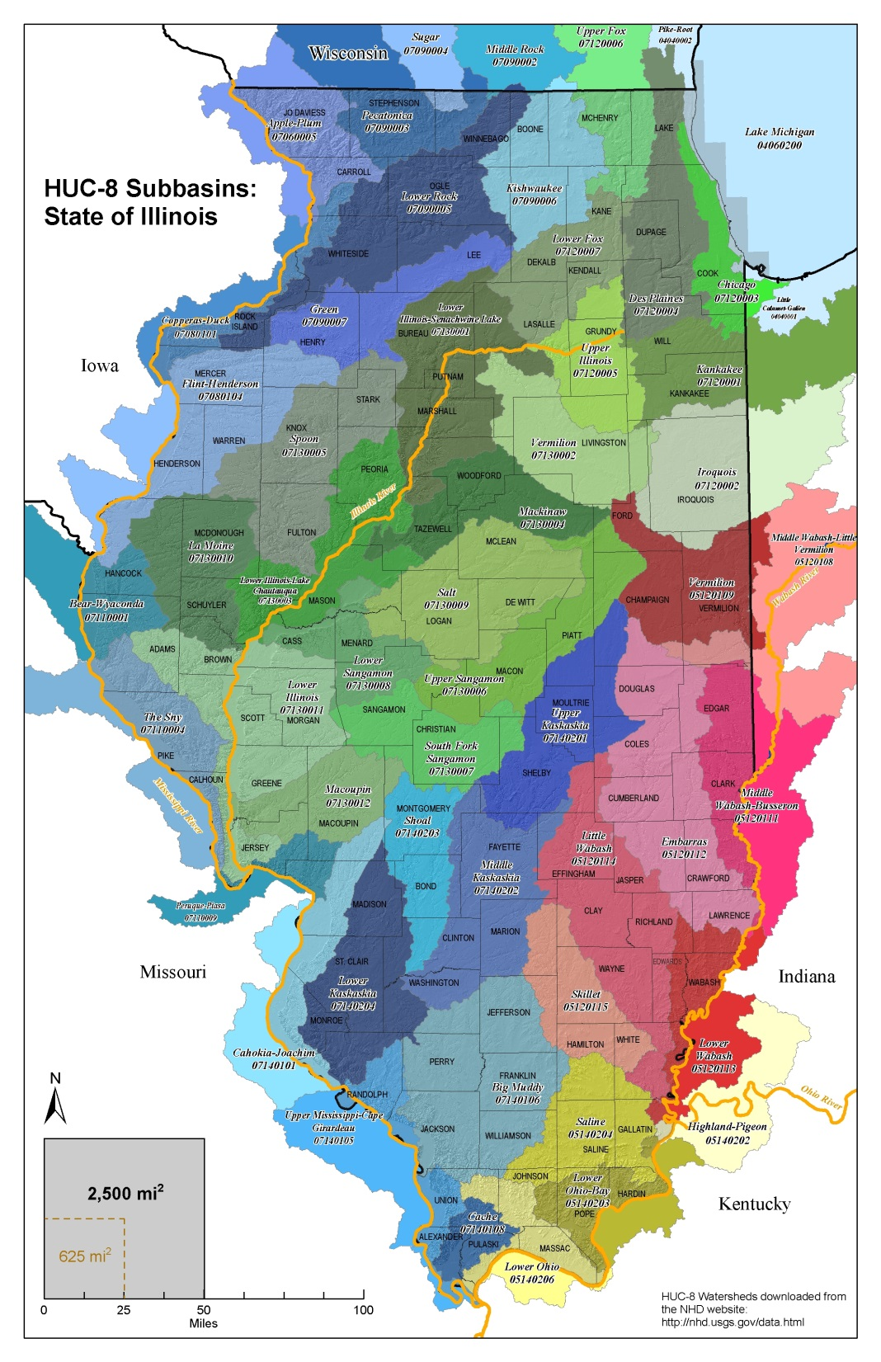

Slide 12
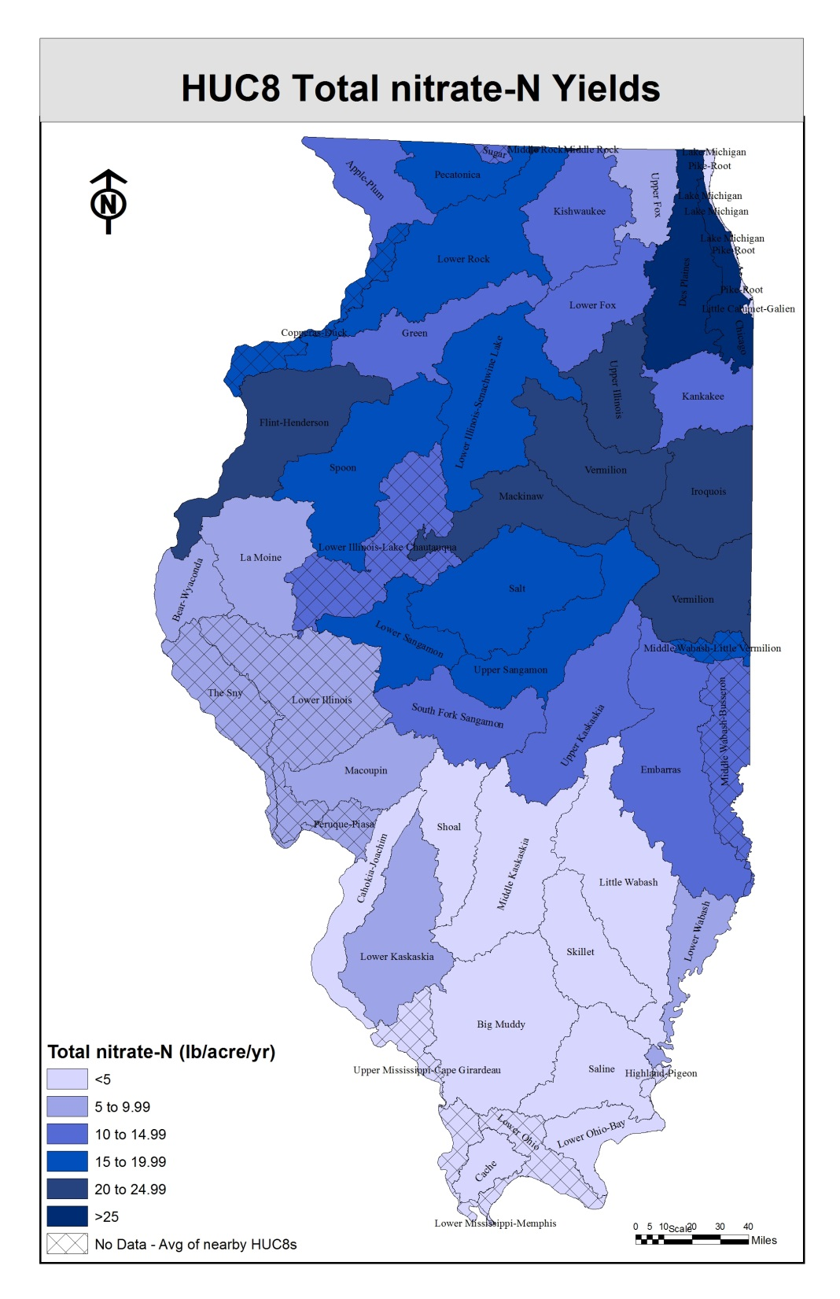

Slide 13
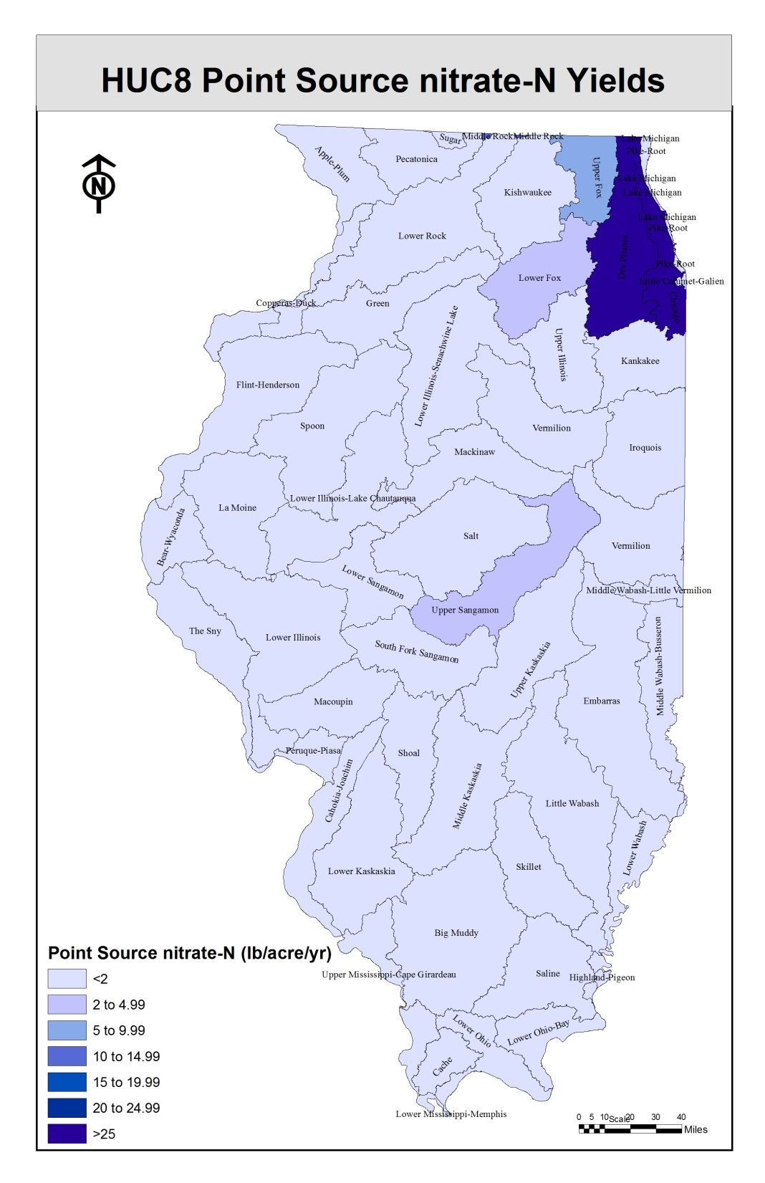

Slide 14
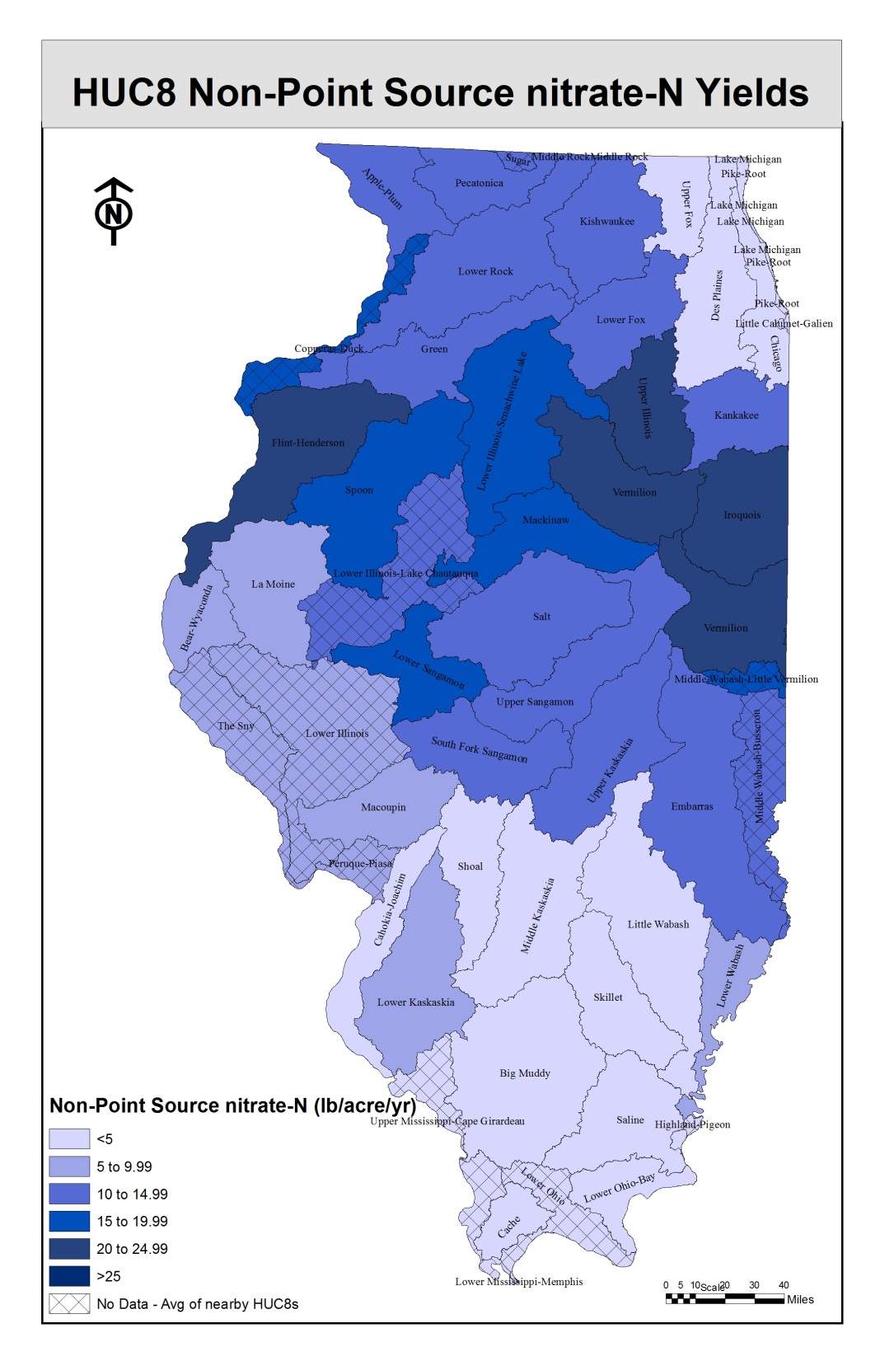

Slide 15
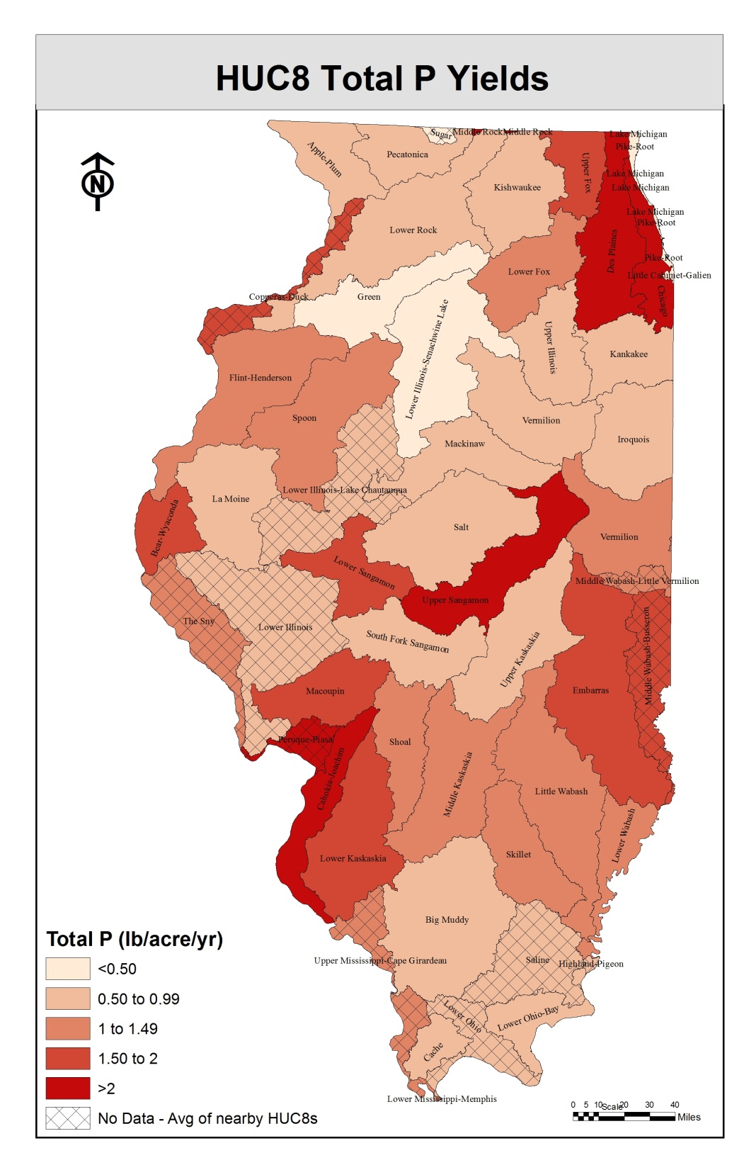

Slide 16
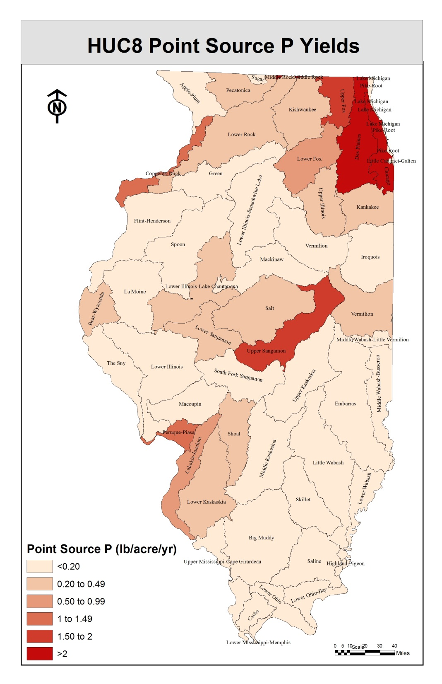

Slide 17
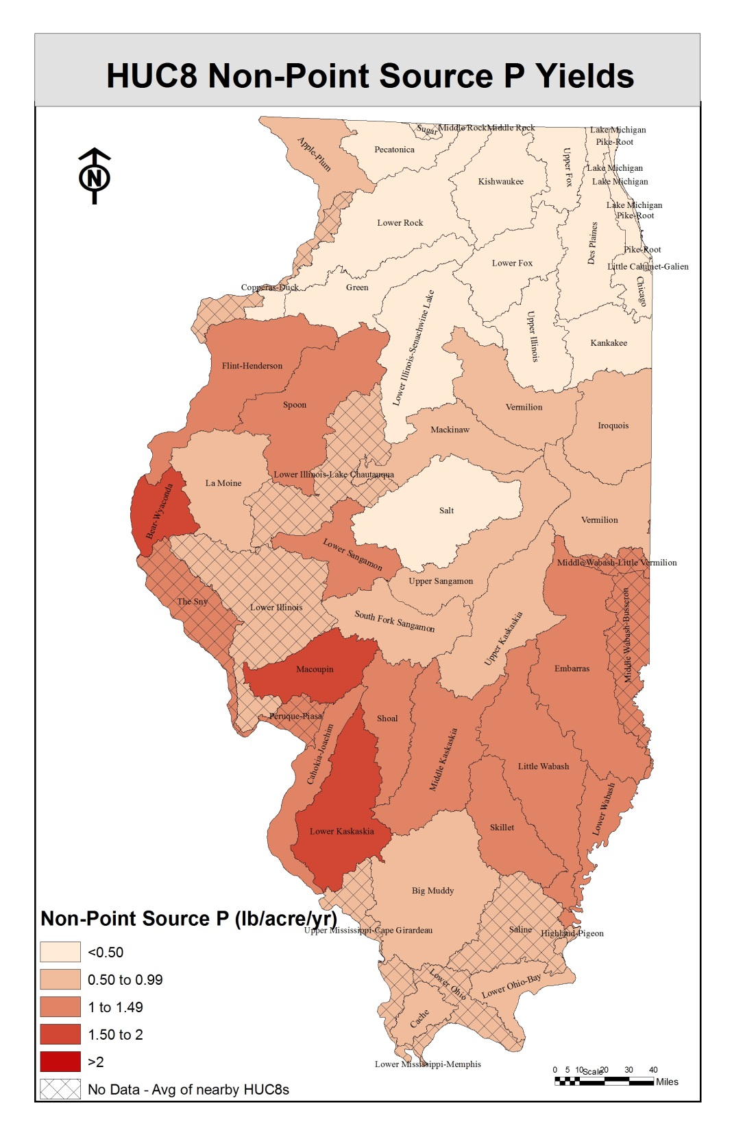

Slide 18
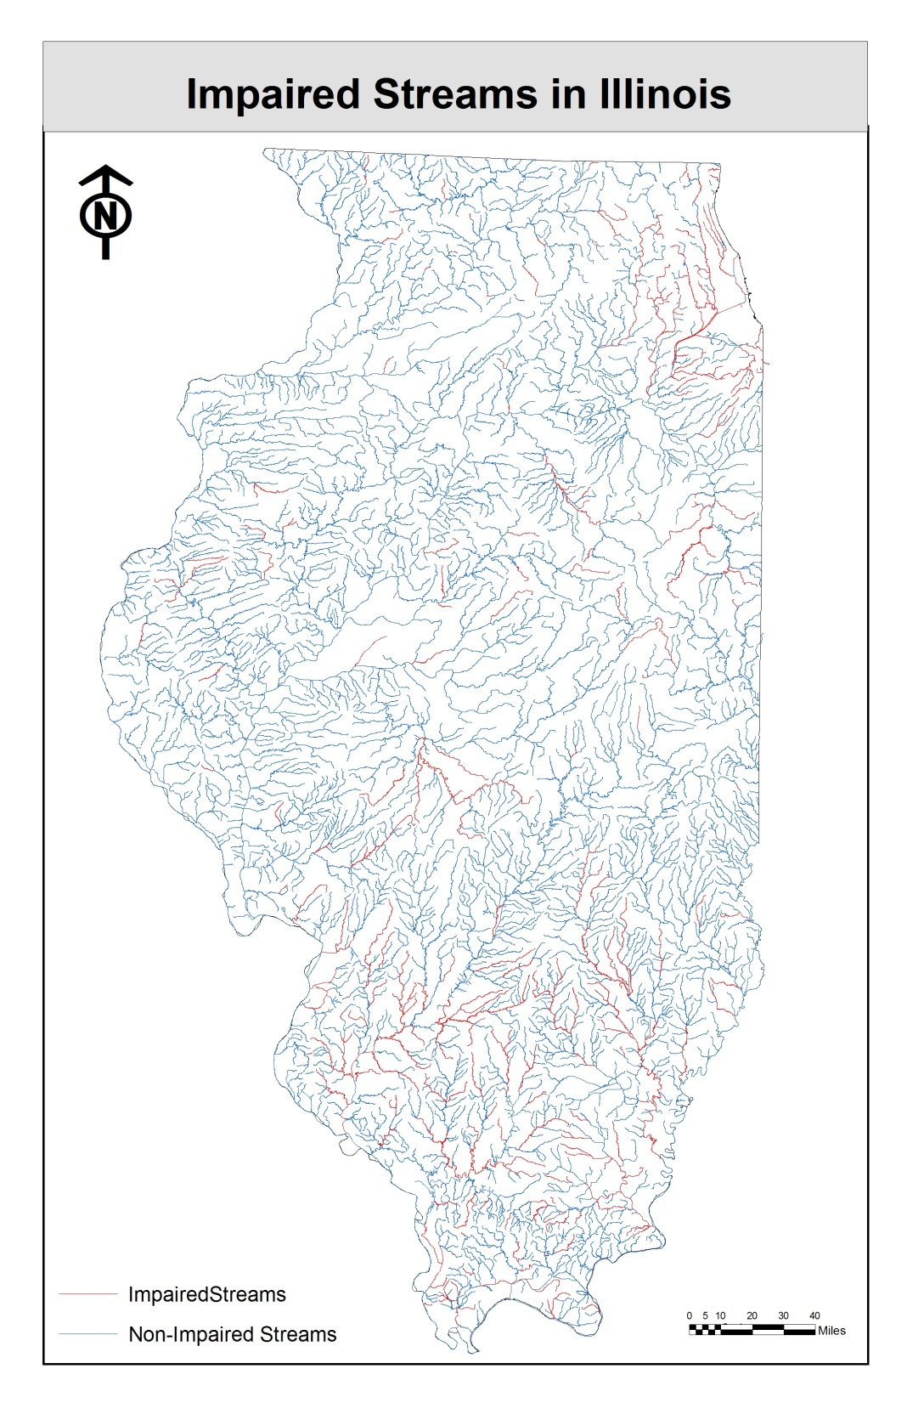
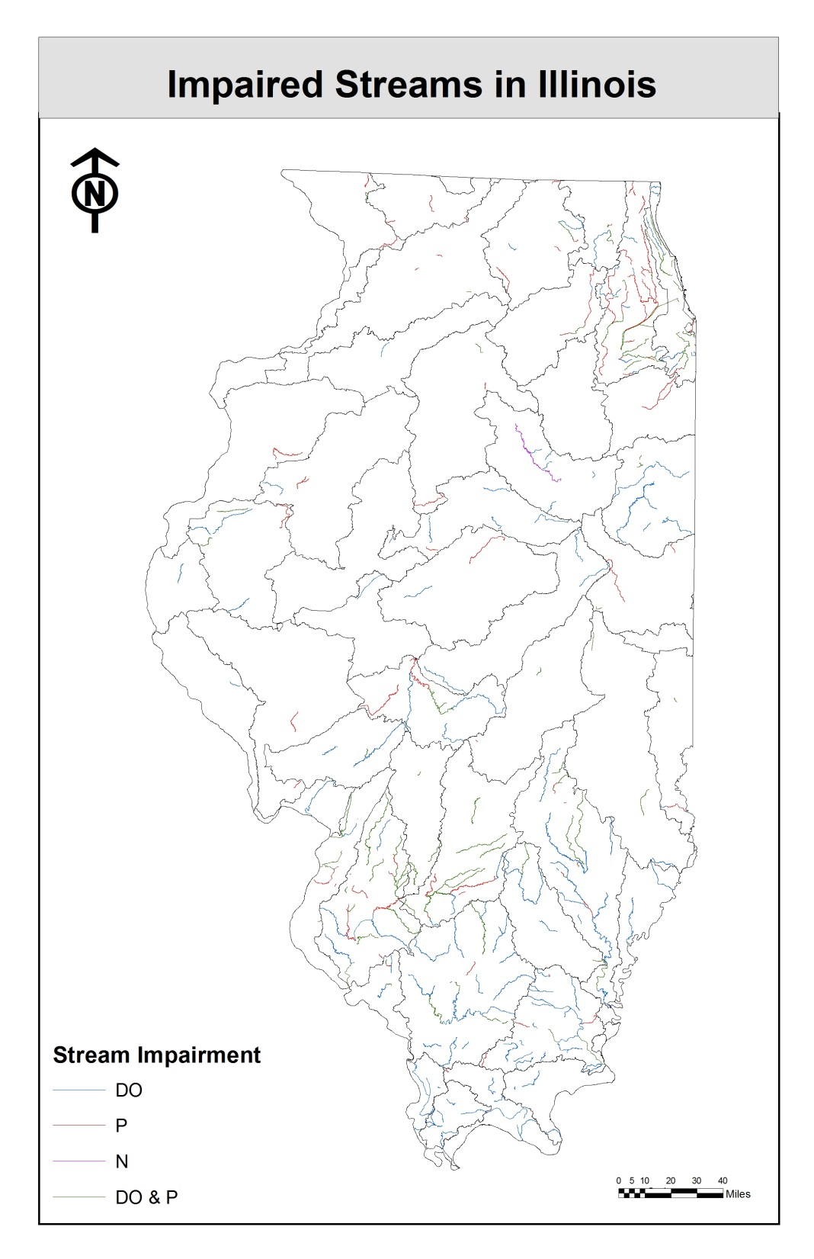

Slide 19
Relationship of 303d miles to N and P
weak overall
Dissolved oxygen impairments may not be due to nutrients
best correlation (p=0.03) of 303d miles with point source N
next with point source P (p=0.09)
non-point source N correlated, but negatively (p=0.002)

Slide 22
3. Estimate Potential Reductions and Costs
estimate field-level effectiveness of various agricultural management practices
  utilize SAB, Iowa, and Lake Bloomington Project estimates
  knowledge in Illinois
determine possible point source reductions
estimate costs
  Gary Schnitkey (agricultural economist) will lead
  initial investments
  likely to annualize costs over 25 years

Slide 23
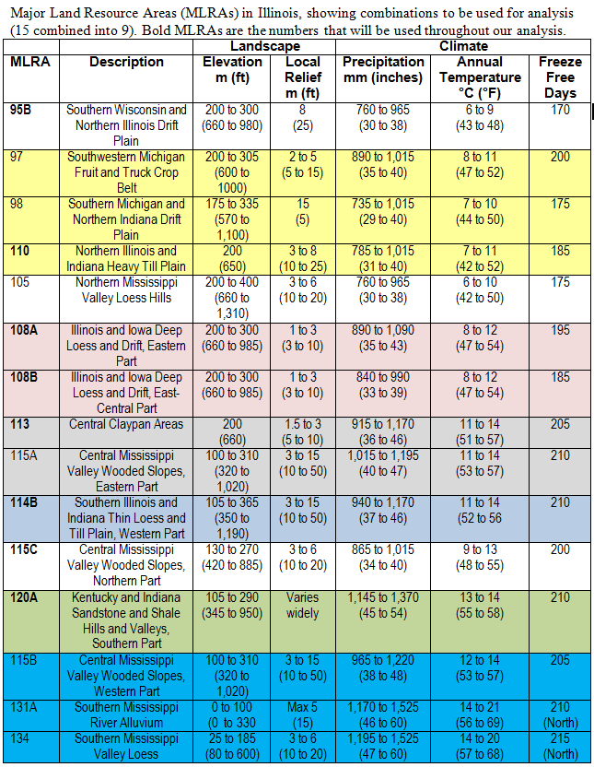
Combined MLRA’s

Slide 24
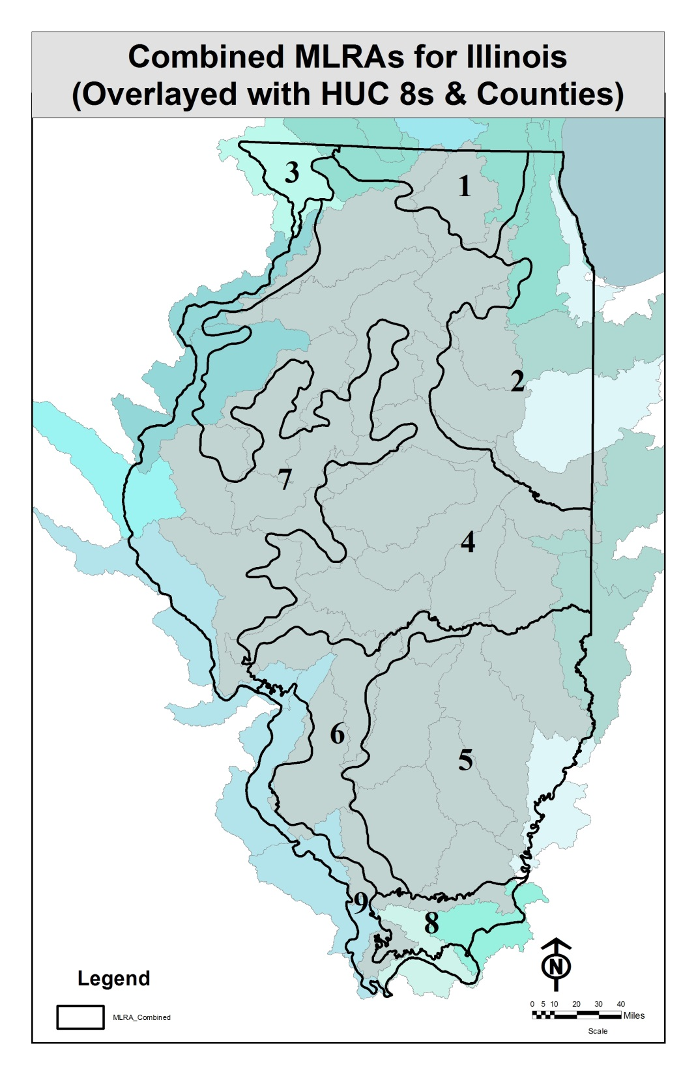

Slide 25
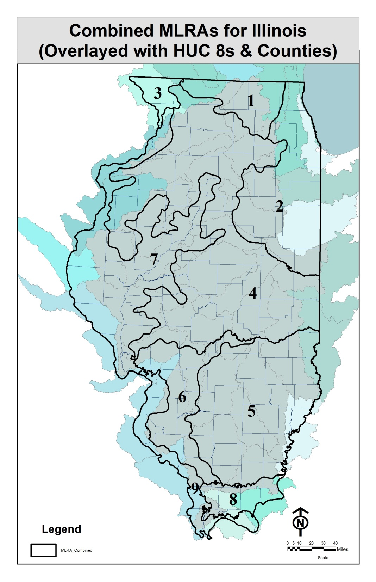

Slide 26
Agricultural Management by MLRA
Combined MLRA | Description | Corn (acres) | Soybean (acres) | Wheat (acres) | Drained acres (% of crop acres) | Corn yield (bushels/acre) | Soybean yield (bushels/acre)
MLRA 1 | Northern Illinois drift plain | 515,905 | 224,186 | 20,192 | 288,491 (39) | 161 | 48
MLRA 2 | Northeastern Illinois heavy till plain | 1,532,100 | 1,111,885 | 42,404 | 2,063,695 (78) | 150 | 39
MLRA 3 | Northern Mississippi Valley | 163,507 | 52,432 | 1,975 | 20,942 (10) | 160 | 50
MLRA 4 | Deep loess and drift | 5,579,980 | 3,343,444 | 76,078 | 5,437,807 (61) | 164 | 52
MLRA 5 | Claypan | 1,609,633 | 1,991,939 | 352,839 | 310,087 (9) | 128 | 39
MLRA 6 | Thin loess and till | 664,242 | 689,773 | 161,180 | 226,971 (17) | 130 | 42
MLRA 7 | Central Mississippi Valley, Northern Part | 2,058,853 | 1,288,686 | 73,884 | 1,284,588 (38) | 155 | 49
MLRA 8 | Sandstone and shale hills and valleys | 83,969 | 115,244 | 10,658 | 49,565 (25) | 103 | 33
MLRA 9 | Central Mississippi Valley, Western Part | 203,736 | 314,662 | 78,250 | 23,769 (5) | 125 | 39
Sum |  | 12,411,925 | 9,132,251 | 817,460 | 9,705,916 (43)
Average crop acres and yields 2008 through 2012

Slide 27
Agricultural N Management by MLRA
Combined MLRA | Description | Estimated corn fertilizer (lbs N/acre/yr) | Estimated corn fertilizer + manure (lbs N/acre/yr) | Row crops (acres) | Nitrate-N yield per row crop acre (lbs N/acre/yr)
MLRA 1 | Northern Illinois drift plain | 152 | 168 | 760,283 | 20.4
MLRA 2 | Northeastern Illinois heavy till plain | 158 | 164 | 2,686,389 | 25.0
MLRA 3 | Northern Mississippi Valley | 135 | 158 | 217,914 | 31.3
MLRA 4 | Deep loess and drift | 150 | 159 | 8,999,502 | 19.6
MLRA 5 | Claypan | 180 | 196 | 3,954,411 | 6.6
MLRA 6 | Thin loess and till | 156 | 170 | 1,515,195 | 7.4
MLRA 7 | Central Mississippi Valley, Northern Part | 155 | 169 | 3,421,423 | 24.5
MLRA 8 | Sandstone and shale hills and valleys | 209 | 219 | 209,871 | 3.9
MLRA 9 | Central Mississippi Valley, Western Part | 192 | 204 | 596,648 | 4.0
Sum |  | 157 | 168 | 22,361,636

Slide 28
Corn Fertilizer N by MLRA
Combined MLRA | Description | Estimated CS fertilizer + manure (lbs/acre/yr) | MRTN (10 to 1) CS (lbs N/acre/yr) | Estimated CC fertilizer + manure (lbs/acre/yr) | MRTN (10 to 1) CC (lbs N/acre/yr)
MLRA 1 | Northern Illinois drift plain | 156 | 146 | 196 | 199
MLRA 2 | Northeastern Illinois heavy till plain | 151 | 155 | 190 | 197
MLRA 3 | Northern Mississippi Valley | 146 | 146 | 184 | 199
MLRA 4 | Deep loess and drift | 147 | 155 | 185 | 197
MLRA 5 | Claypan | 181 | 171 | 227 | 189
MLRA 6 | Thin loess and till | 157 | 171 | 198 | 189
MLRA 7 | Central Mississippi Valley, Northern Part | 156 | 163 | 197 | 194
MLRA 8 | Sandstone and shale hills and valleys | 202 | 171 | 254 | 189
MLRA 9 | Central Mississippi Valley, Western Part | 188 | 171 | 237 | 189
MRTN is Maximum Return to N

Slide 29
Nitrate Yield by MLRA
Combined MLRA | Description | Drained cropland (acres) | Nitrate-N yield per row crop acre (lbs N/acre/yr) | Nitrate-N yield per tile drained acre (lbs N/acre/yr) | Nitrate-N yield from non-tiled land (lbs N/acre/yr)
MLRA 1 | Northern Illinois drift plain | 288,491 | 20.4 | 43 | 6.6
MLRA 2 | Northeastern Illinois heavy till plain | 2,063,695 | 25.0 | 29 | 10.8
MLRA 3 | Northern Mississippi Valley | 20,942 | 31.3 |  | 31.3
MLRA 4 | Deep loess and drift | 5,437,807 | 19.6 | 26 | 9.9
MLRA 5 | Claypan | 310,087 | 6.6 |  | 6.6
MLRA 6 | Thin loess and till | 226,971 | 7.4 | 30 | 3.5
MLRA 7 | Central Mississippi Valley, Northern Part | 1,284,588 | 24.5 | 46 | 11.8
MLRA 8 | Sandstone and shale hills and valleys | 49,565 | 3.9 |  | 3.9
MLRA 9 | Central Mississippi Valley, Western Part | 23,769 | 4.0 |  | 4.0

Slide 30
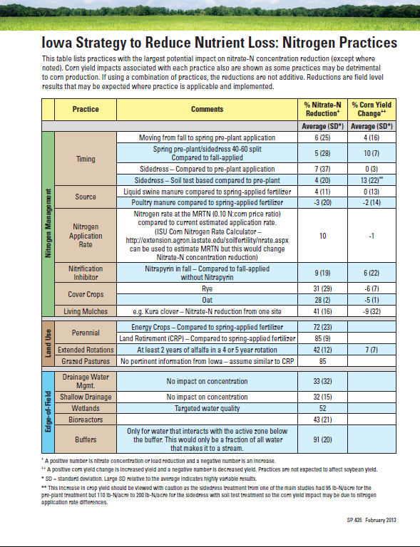
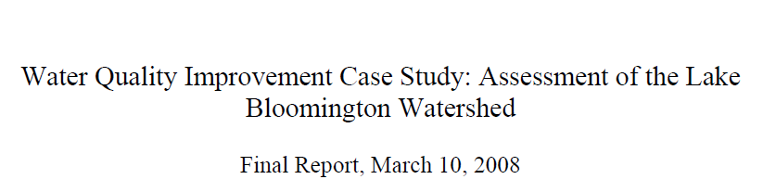
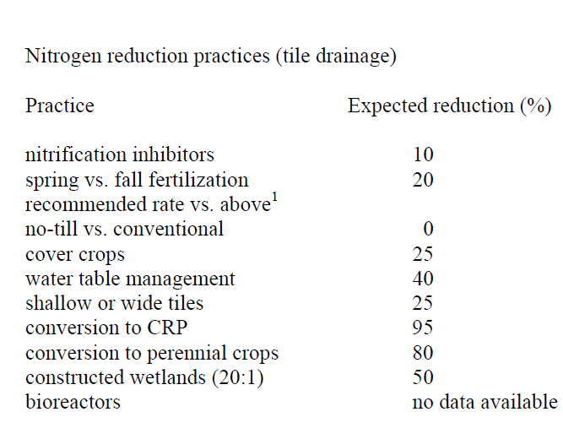

Slide 31
Example Statewide Results
Practice/Scenario | % reduction per acre | Nutrient reduced (million lbs) | Total Load (million lbs) | Nutrient Reduction % (from baseline)
Baseline
Nitrogen or phosphorus management in field
Edge-of-field
Landscape change
Point source management

Slide 32
Example Statewide Results for N
 | Practice/Scenario | % Nitrate-N reduction per acre | Nitrate-N reduced (million lbs N) | Total Load (million lbs N) | Nitrate-N Reduction % (from baseline)
 | Baseline |  | 188 | 410
 | Reducing N rate from background to the MRTN (10% of acres) | 10 | 4 |  | 1.0
 | Nitrification inhibitor with all fall applied fertilizer | 10 | 6 |  | 1.5
 | Split (50%) fall and spring (50%) on tile-drained corn acres | 7.5 to 10 | 10 |  | 2.5
 | Fall to spring on tile-drained corn acres | 15 to 20 | 21 |  | 5.0
 | Cover crops on all corn/soybean tile-drained acres | 30 | 84 |  | 20.5
 | Cover crops on all corn/soybean non-tiled acres | 30 | 32 |  | 7.9
 | Bioreactors on 50% of tile-drained land | 40 | 56 |  | 13.6
 | Wetlands on 25% of tile-drained land | 40 | 35 |  | 8.5
 | Buffers on all applicable crop land (reduction only for water that interacts with active area) | 90
 | Perennial/energy crops equal to pasture/hay acreage from 1987 | 90 | 10 |  | 2.5
 | Perennial/energy crops on 10% of tile-drained land | 90 | 25 |  | 6.1
 | Point source reduction to 6 mg nitrate-N/L |  | 35 |  | 8.5
 | Point source reduction in N due to biological nutrient removal for P |  | 8 |  | 1.8
In-field
Edge-of-field
Land use change
Point source

Slide 33
Agricultural P Management by MLRA
Combined MLRA | Description | Estimated fertilizer (lbs P/acre/yr) | Estimated manure (lbs P/acre/yr) | Row crops (acres) | Total P yield per row crop acre (lbs P/acre/yr)
MLRA 1 | Northern Illinois drift plain | 14.9 | 3.9 | 760,283 | 0.71
MLRA 2 | Northeastern Illinois heavy till plain | 13.4 | 1.3 | 2,686,389 | 0.68
MLRA 3 | Northern Mississippi Valley | 13.4 | 5.4 | 217,914 | 1.72
MLRA 4 | Deep loess and drift | 13.6 | 2.3 | 8,999,502 | 0.96
MLRA 5 | Claypan | 11.7 | 2.4 | 3,954,411 | 1.74
MLRA 6 | Thin loess and till | 11.3 | 2.5 | 1,515,195 | 2.09
MLRA 7 | Central Mississippi Valley, Northern Part | 13.6 | 3.4 | 3,421,423 | 1.45
MLRA 8 | Sandstone and shale hills and valleys | 11.3 | 1.3 | 209,871 | 2.82
MLRA 9 | Central Mississippi Valley, Western Part | 11.0 | 1.6 | 596,648 | 2.82
Sum |  |  |  | 22,361,636

Slide 34
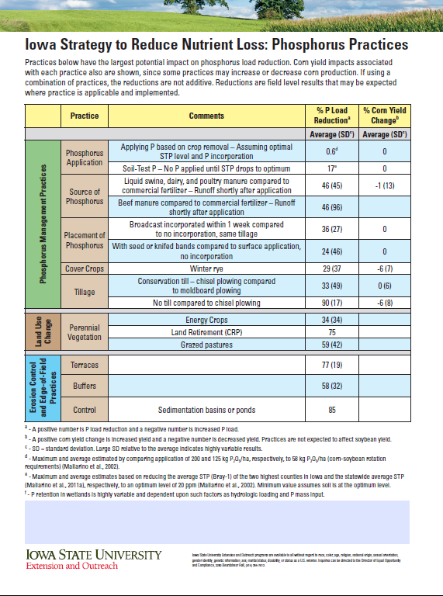
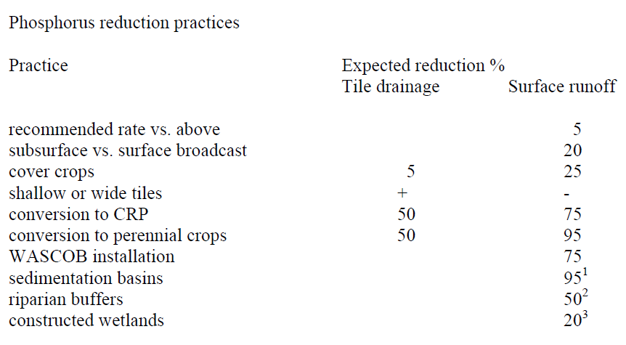

Slide 35
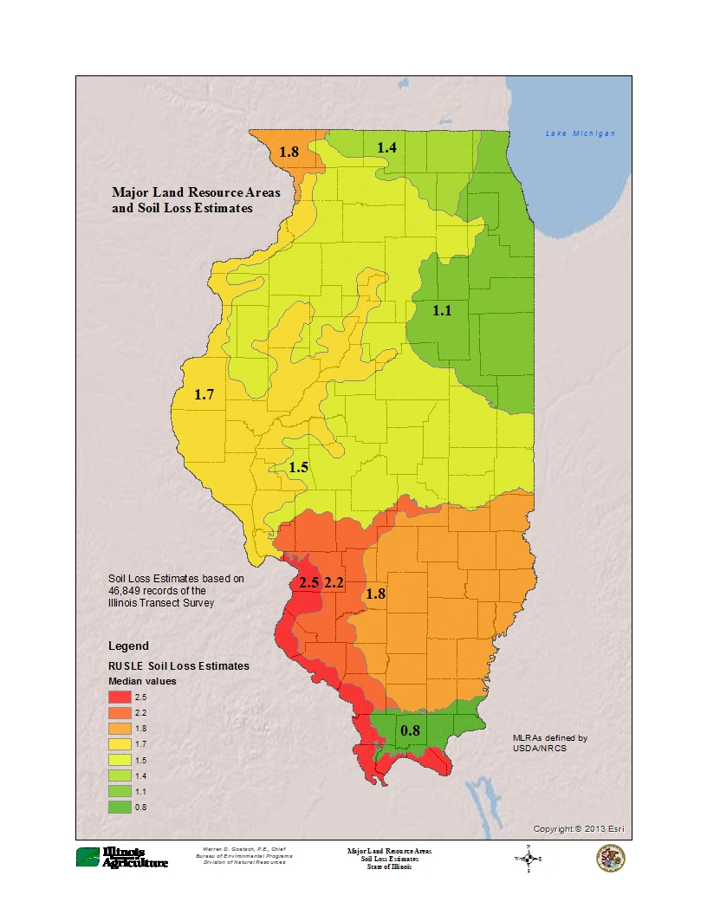
Illinois
Dept. of Ag Transect Survey
Median
Soil Loss Estimates

Slide 36
Non-point TP yield from MLRAs as a function of median soil erosion estimates

Slide 37
Sediment TP Reduction by MLRA
MLRA | % fields > 5 ton/ac | Avg. RUSLE >5 ton/ac (ton/ac) | SDR | TP reduction (million lb/yr)
1 | 8.0 | 7.8 | 0.16 | 0.08
2 | 3.3 | 7.2 | 0.14 | 0.05
3 | 18.3 | 8.7 | 0.18 | 0.10
4 | 8.2 | 8.2 | 0.12 | 0.72
5 | 14.1 | 8.9 | 0.13 | 0.50
6 | 18.6 | 9.0 | 0.15 | 0.35
7 | 14.9 | 9.0 | 0.13 | 0.74
8 | 15.3 | 13.0 | 0.17 | 0.08
9 | 24.3 | 12.4 | 0.16 | 0.36
Total |  |  |  | 2.99
Future estimates may be refined by using % of fields eroding>T based on IDOA data
and alternative estimates of SDR (e.g., CEAP)

Slide 38
Example Statewide Results for P
 | Practice/Scenario | % Total P reduction per acre | Total P reduced (million lbs P) | Total Load (million lbs P) | Total P Reduction % (from baseline)
 | Baseline |  | 18.8 | 37.5
 | Erosion control to 5 tons per acre on all acres |  | 3.0 |  | 8.0
 | P rate reduction on fields with soil test P above the recommended maintenance level | 20
 | Cover crops on all CS acres | 30 | 5.7 |  | 15.2
 | Incorporation of all P fertilizers | 25
 | Wetlands on 25% of tile-drained land | 0 | 0 |  | 0.0
 | Buffers on all applicable crop land | 60 | 7.2 |  | 19.2
 | Perennial/energy crops equal to pasture/hay acreage from 1987 | 90 | 1.0 |  | 2.7
 | Perennial/energy crops on 10% of tile-drained land | 50 | 0.3 |  | 0.8
 | Point source reduction to 1 mg total P/L limit (0.7 mg P/L actual) |  | 10.6 |  | 28.3
In-field
Edge-of-field
Land use change
Point source

Slide 39
Point Source P Estimates
Point Source Limit (mg P/L) | million lbs of P reduced | % of target (18.8 million lbs P)
All majors to 1 mg/L standard (0.7 mg P/L actual) | 10.4 | 55
Top 20 majors to 0.7 | 6.1 | 32
Top 30 majors to 0.7 | 7.0 | 37
Top 50 majors to 0.7 | 7.8 | 41
All majors to 0.3 | 13.1 | 70
Top 20 majors to 0.3 | 8.0 | 42
Top 30 majors to 0.3 | 8.9 | 47
Top 50 majors to 0.3 | 9.9 | 52
Total P from point sources currently ~18.1 million lbs P per year

Slide 40
4. Develop Scenarios
provide a range of scenarios to meet reduction targets
  area needed by practice
  initial investment and annualized costs
  point and non-point source reductions
could have range of targets (20%, 30%, 45%)
focus reduction practices on most critical watersheds (HUC8s)

